Slide 1

Department of Electronics & Communication Engineering
LOAD CONTROLLER USING IOT
PRESENTED BY,
NAME: Hari Krishnan.D
Madhan.S
Deivanayagam.S
Programme: ECE department
Roll No: 727621bec013
727621bec025
727621bec073
GUIDED BY : DR.kannapiran.B

Slide 2
Objective

Slide 3
Abstract
An measure the amount of energy consumed by domestic, commercial and industrial user, energy meter is being used.
In this work, the system uses microcontroller with inbuilt WIFI facility because it is energy efficient hence it consumes less power.
All the data monitoring is done via a web based portal provided with a dedicated internet connection.
Notes:
e

Slide 4
Introduction
As the population of energy consumers are gradually increasing the smart energy meter helps to ease the energy management system.
All the data monitoring is done via a web based portal provided with a dedicated internet connection.
So in order to overcome the stress, smart energy meter is introduced. In this work, the system uses microcontroller with inbuilt WIFI facility because it is energy efficient hence it consumes less power

Slide 5
Literature survey
Sl.No | Authors | Title of the paper | Journal | Year

Slide 6
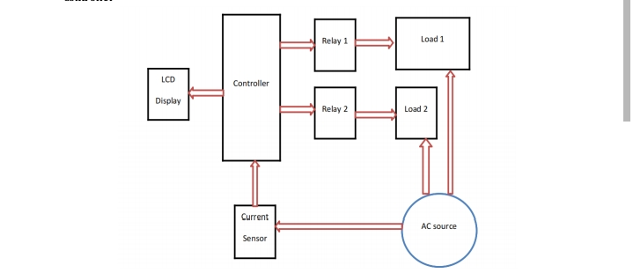
Block diagram

Slide 7
Tools to be used for implementing the project
Ac source
Mosfet
Node mcu
LCD display
Resister
Transistor
Relay
Load(Ex light fan)

Slide 8
Work plan
Week Tasks | Week1 (Mention the date here) | Week2 (Mention the date here) | Week3 (Mention the date here) | …… | …… | ……..
Task1
Task2
Task3

Slide 9
Work Completed for First review (Explain the completed tasks)
Week Tasks | Week1 (Mention the date here) | Week2 (Mention the date here) | Week3 (Mention the date here) | …… | Status
Task1 | Topic discussion |  |  |  | Completed
Task2 |  |  |  |  | Completed
Task3 |  |  |  |  | In-progress

Slide 10
Results
We are reducting the power and monitoring the power and unit.
Lcd display is used to monitoring the system nodemcu is used.
At the time device is connected power conception is increased we will monitoring and we reduce power conception

Slide 11
References

